Slide 1
FDA Standards Development Initiatives and Role of an Information Model

Slide 2
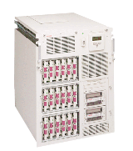



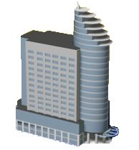



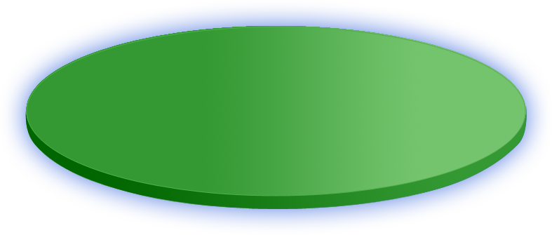




Role of Standards in Health Information Networks
EHR
Enterprise
Portal
HIS
Data
W/H
Hospital
Lab
HL7
Health Information Network
HL7
HL7 Study Data Exchange Standards
Radiology
DICOM
FDA
HL7
HL7
HL7
Sponsor
Clinical Investigator

Slide 3
FDA Data Exchange Standards
Based on HL7 RIM
Research study design, study participation and subject data
  Study design
  Study participation
  Subject data
Product adverse event reports
  Individual Case Safety Report (ICSR)
Product labeling, facility registration and product listing
  Structured Product Labeling (SPL)
Product investigational and marketing applications
  Regulatory Product Submission (RPS)
Product stability test results
  Product Stability Data
ECG results and annotations
  Annotated ECG waveform Data

Slide 4
Data Management Strategy
Data Pyramid
Exchange Layer
HL7 files (XML)
Study Data n SPL ICSR
Source Layer
R I M Database
Database Layer
Janus Study (Clinical & Nonclinical) Database
Database n
eLIST
Database
FAERS Database
Analysis view
Layer
Human Study
(Analysis Views)
Animal Study (Analysis Views)
Efficacy study
(Analysis Views)
Data Mart n
Product Info
(Analysis Views)
FAERS
(Analysis Views)
Tools
Layer
SAS (Software Application)
ireview (Software Appication)
JMP (Software Applicaton)
S Plus (Software Application)
Product Info
(Software Application)
Analysis
Software n
FAERS
(Software
Application)
Review Layer
Results support science based regulatory decisions

Slide 5

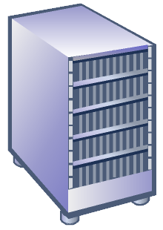
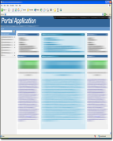

Sponsor Manages Data
Biopharma/
Device Company
FDA
Data
Manager
Analytics
Server
XPT Data views
Datasets
Software
Reviewer

Slide 6
FDA Manages Data
Biopharma/
Device Company
FDA
1. Exchange Layer
HL7 Study Data
Exchange Standard
HL7 V3 RIM Database
2. Source Layer
Data
Manager
Analytics
Server
3. Database Layer
Janus Data Warehouse
Datasets
4. Analysis Layer
Software
5. Tool Layer
6. Review Layer
Reviewer

Slide 7
Study Design
Exchange information on the design, analysis
process and intent of an individual study
Data on trial design
Eligibility criteria
Analysis comparables
Subject assignment
Planned visits
Planned Interventions
Study characteristics

Slide 8
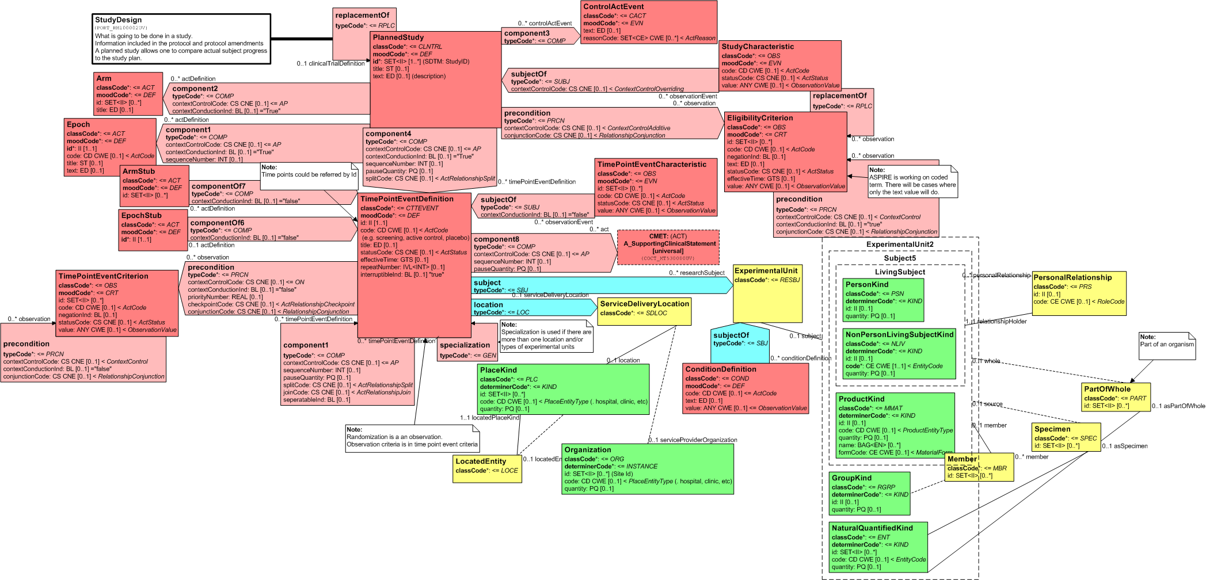
Study Design RMIM

Slide 9
Study Participation
Exchange information about experimental units, investigators, and other relevant entities that are involved in the conduct of an individual study.
Investigator participation, including information
about qualifications
Participation of other organizations involved within
the study, and the roles they play in the study

Slide 10
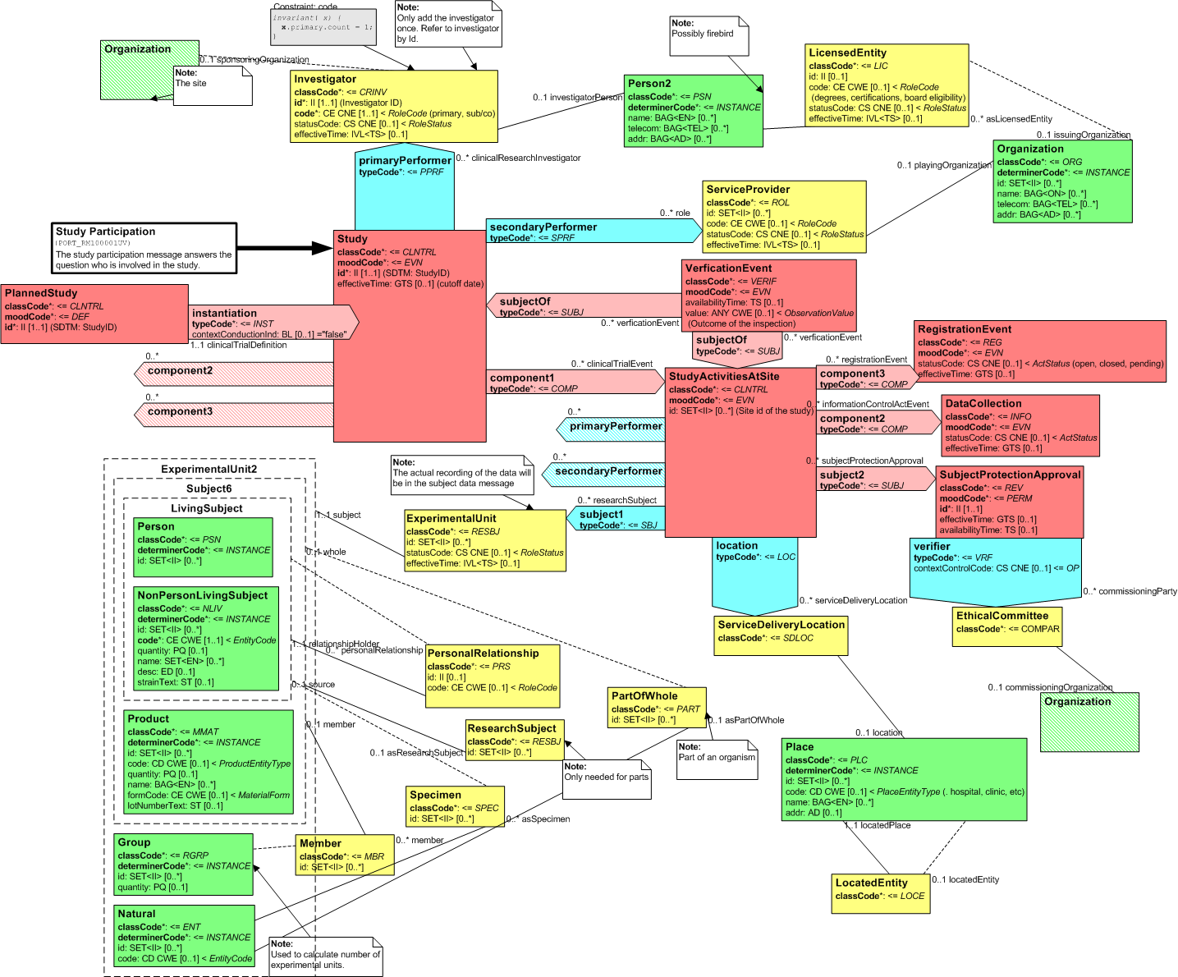
Study Participation RMIM

Slide 11
Subject Data
Exchange information on an individual study subject
Data on subject’s demographics, medical History, social history, etc.
Substance Administration
Observations
Supply
Procedures
Audit trails

Slide 12
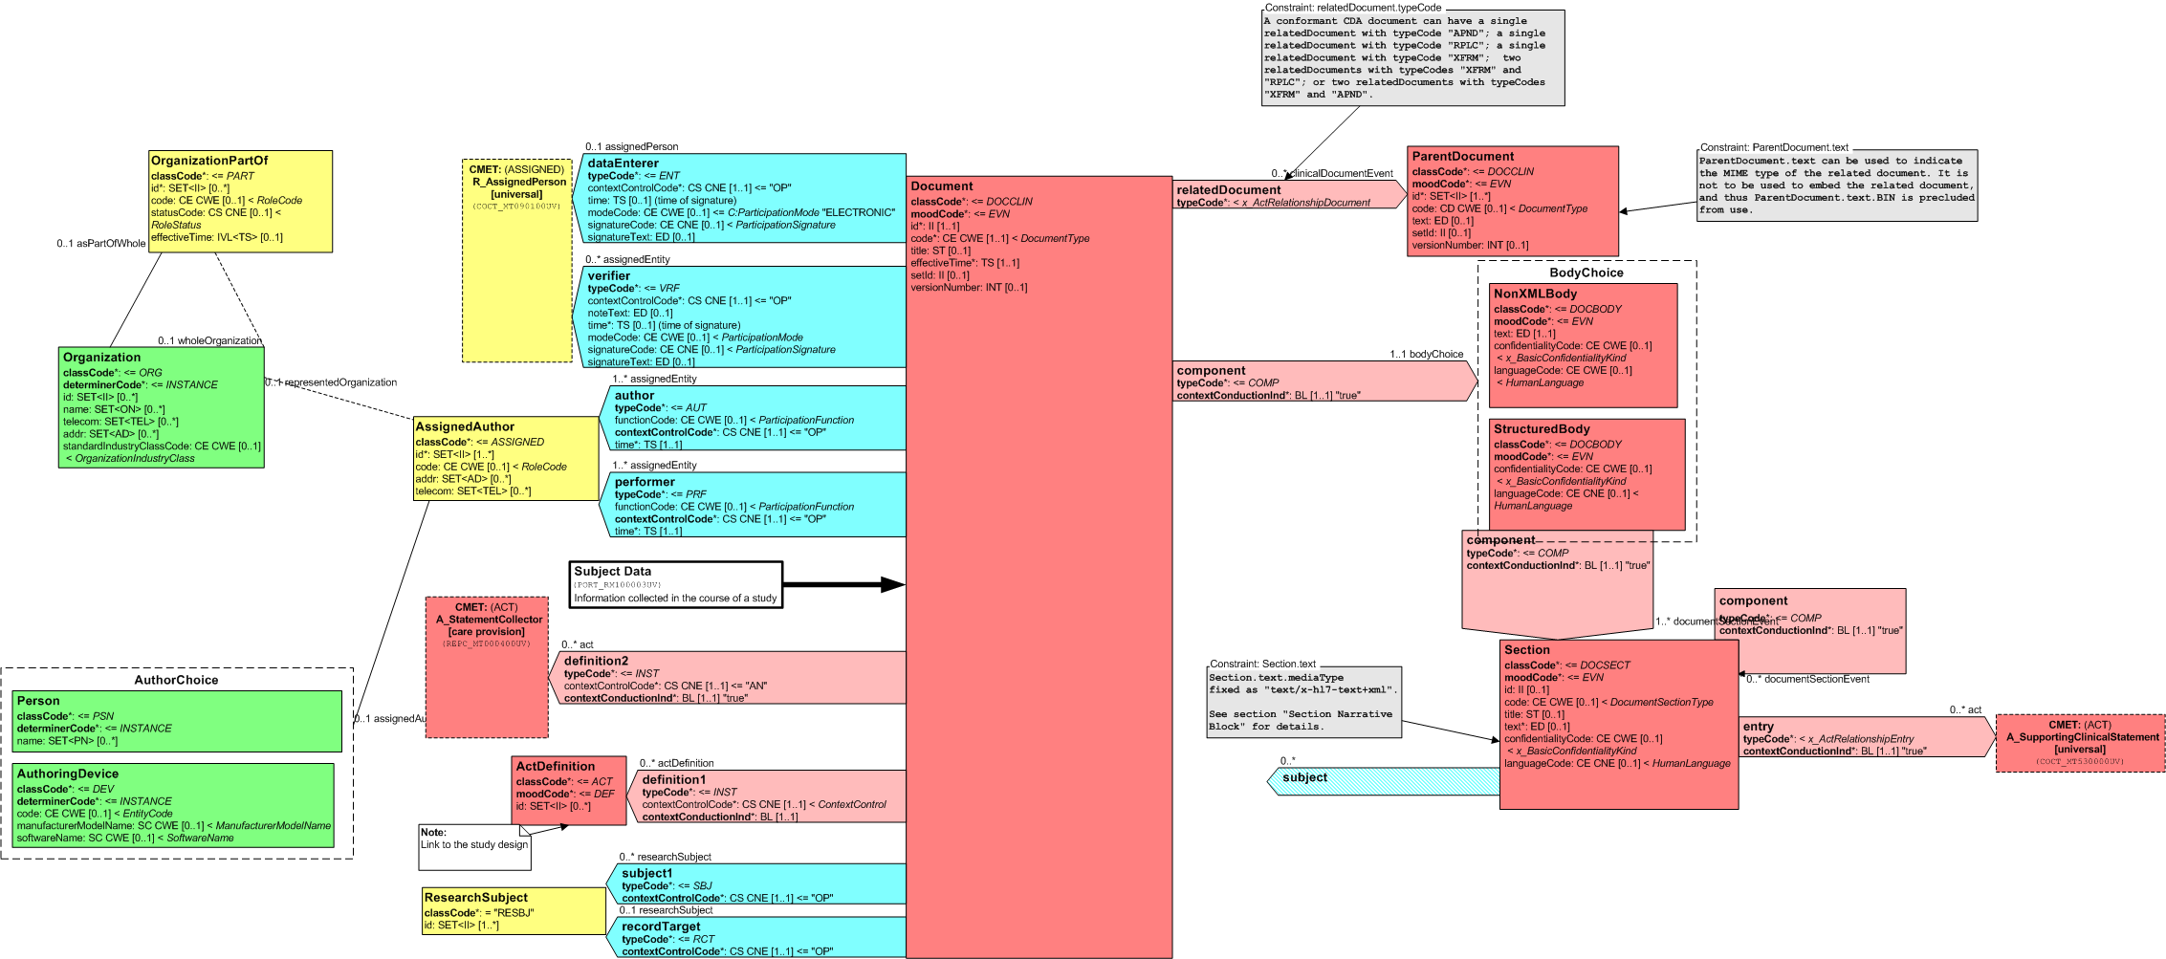
Subject Data RMIM

Slide 13
Individual Case Safety Report (ICSR)
Exchange information on an adverse event occurring during a study.
Data on adverse events

Slide 14
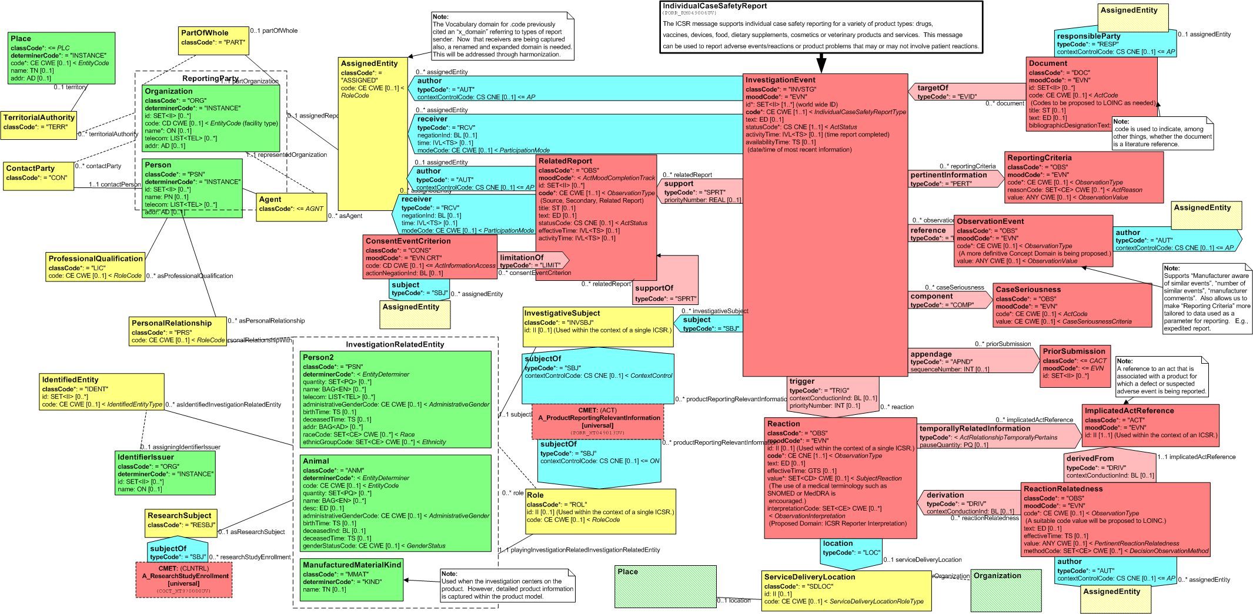
Individual Case Safety Report (ICSR)
RMIM

Slide 15
Structured Product Labeling
Structured Product Labeling (SPL) is an exchange standard for product information
specifies the structure and semantics of the content of authorized published information that accompanies any medicine licensed by a medicines licensing authority. Also known as
product label
package insert
prescribing information
product information
medicines information

Slide 16
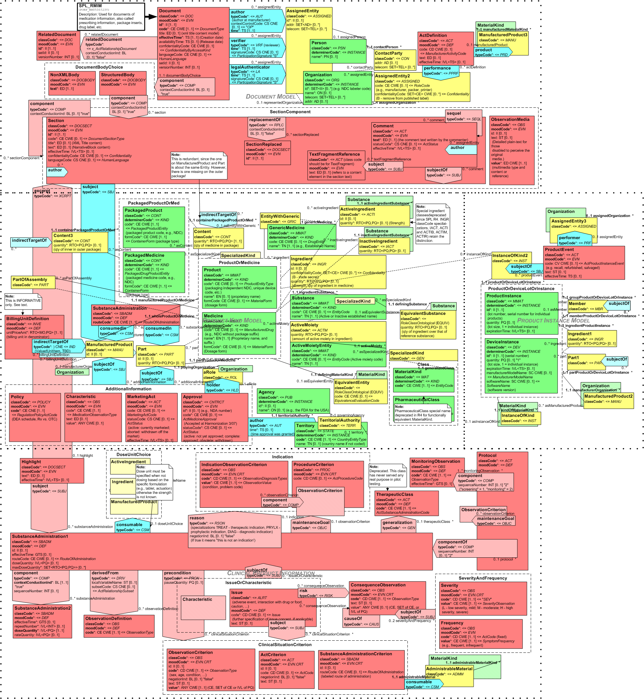
Structured Product Labeling RMIM

Slide 17
Regulated Product Submission
RPS captures all information required for the efficient processing and review of regulatory submissions.
Notes:
Submitted documentation will be clearly identified using predefined parameters

Slide 18
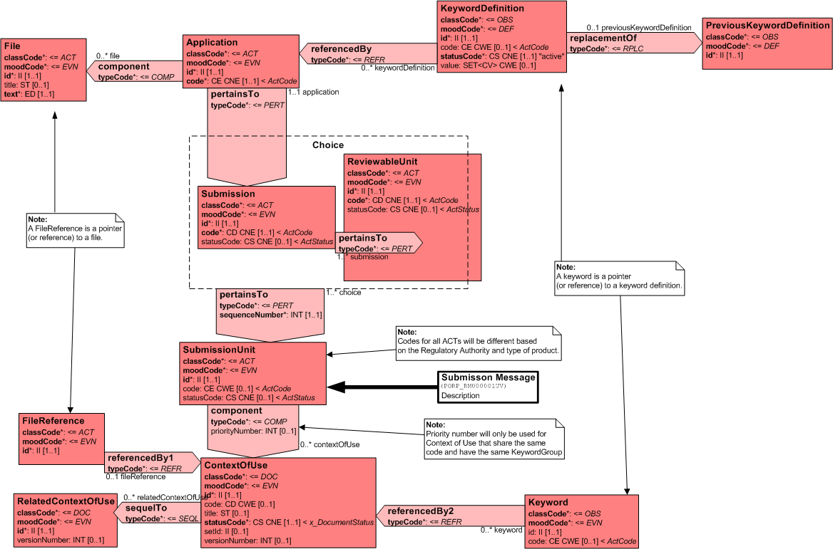
Regulated Product Submission Release 1

Slide 19
Annotated ECG
This standard captures annotated digital waveform data produced by an ECG analysis system for transmission from trial sponsor to a regulatory agency.
Notes:
Clinical trials on candidate drug products often collect biological data from trial subjects as waveforms or algorithmic representations of those waveforms. After the data have been collected, derived measurements such as QT interval are used to draw conclusions about the safety and effectiveness of the candidate drug. Standards exist for transmitting these derived data and their analysis results from the trial sponsor to the regulatory agencies; but these submissions have not historically included representation of the waveforms, or have at best included an image of the device-generated paper waveform.

Slide 20
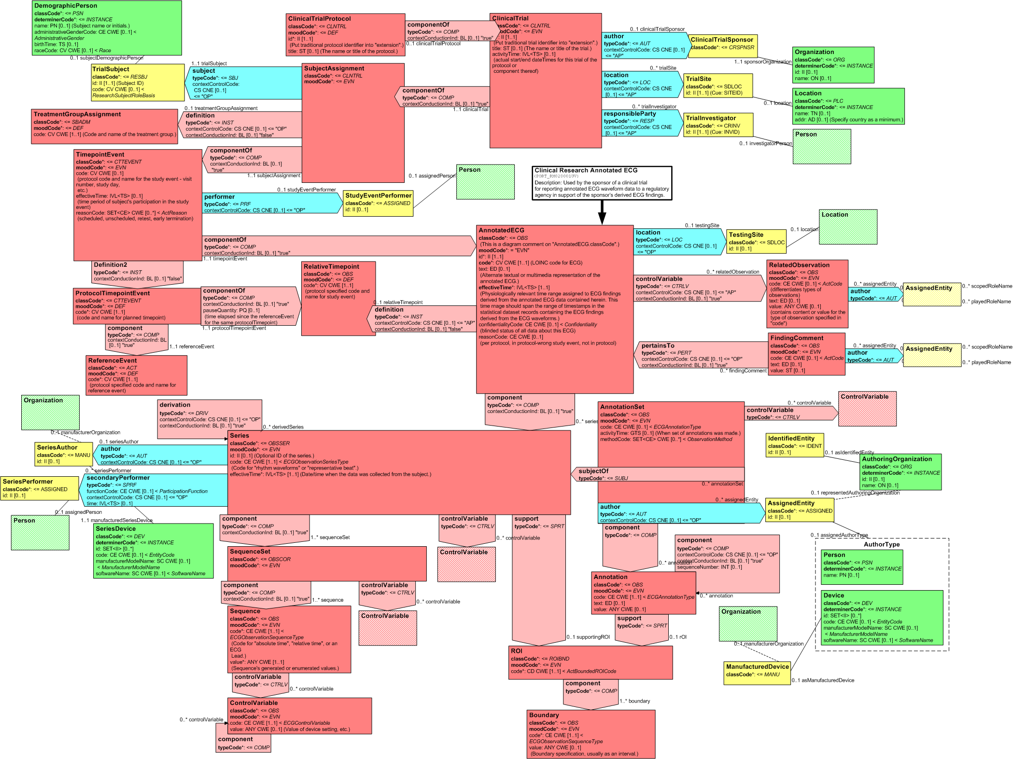
Annotated ECG

Slide 21
BRIDG
The BRIDG Model is a collaborative effort of stakeholders from the Clinical Data Interchange Standards Consortium (CDISC), the HL7 Regulated Clinical Research Information Management Workgroup (RCRIM WG), the National Cancer Institute (NCI), and the US Food and Drug Administration (FDA) to produce a shared view of the dynamic and static semantics that collectively define a shared domain-of-interest, i.e. the domain of clinical and pre-clinical protocol-driven research and its associated regulatory artifacts.

Slide 22
Questions

